Slide 1
Christopher Columbus
by: Lauren Thomas and Lexi Stirland A-3

Slide 2
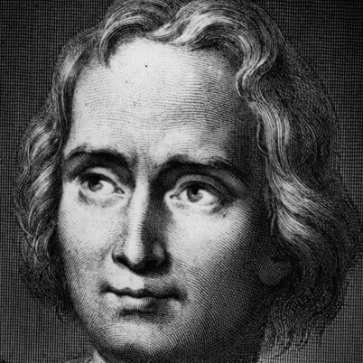
Introduction…
We like Columbus day, and we want it to be even more celebrated! He may have made mistakes, but Columbus helped shape the society that we live in today. Columbus was a great explorer and deserves a holiday.
Notes:
Insert a map of your country.

Slide 3
In the beginning…
Christopher Columbus was born in Genoa, Italy in the year of 1451. Domenico Colombo, a middle class wool-weaver, and Susanna Fontanarossa were his parents. Though historians do not know much about his childhood, it is apparent that he was well-educated because he was able to speak several languages as an adult and had considerable knowledge of classical literature.
So, as you can see Columbus was not a mindless murder who enslaved Native Americans. He was well learned ever since his childhood. He was educated and made choices based on his knowledge.
Notes:
Insert a picture of one of the geographic features of your country.

Slide 4
Sailing allegiance
Christopher Columbus sailed for Spain. He was a fearless sailor who brought glory to his country.
Notes:
Insert a picture illustrating a season in your country.

Slide 5
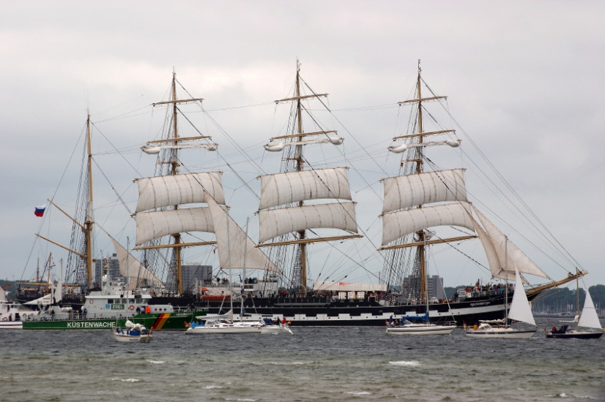
The voyage
Preparations…
Although, as skilled as Columbus was, he was twice rejected by the queen and king of Spain. They doubted him, yet he went on to accomplish great things.
Notes:
Insert a picture of an animal and/or plant found in your country.

Slide 6
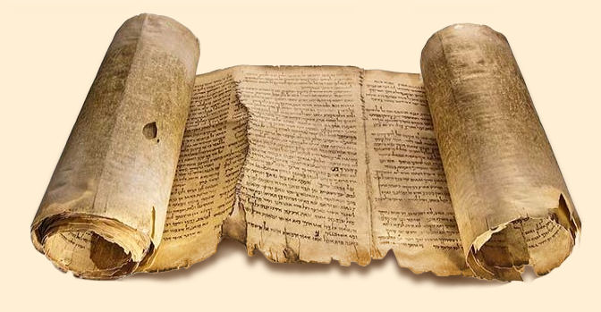
Arrival In the new world
In 1492, Columbus’s arrival in the new world marks the beginning of the America’s recorded history. If Columbus hadn't come, our written history would be much shorter. We wouldn’t know as much as we do about the Native Americans.
Notes:
Add key points in the history of your country to the timeline.

Slide 7
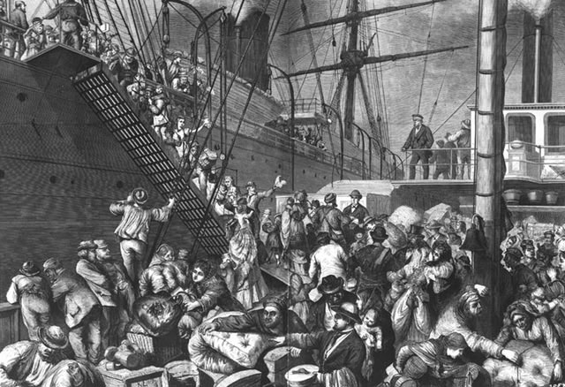
Cultural Exchange
After Columbus, millions of European immigrants came to the Americas. They brought art, music, science, philosophy, and religious ideas. These contributions helped form the way we live today.

Slide 8
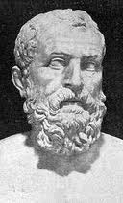
Contributions of the immigrants
The contributions of European immigrants include:
Greek Democracy
Roman Law
Judeo-Christian Ethics
The idea that all men are created equal

Slide 9
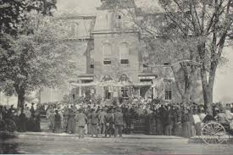
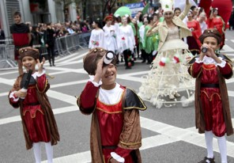
tradition
Columbus Day dates back to the 18th century.
It was first celebrated on October 12^{th,} 1792, the 300th anniversary of his first voyage. It has become part of our culture.

Slide 10

Patriotism
Columbus Day is a patriotic holiday. The Pledge of Allegiance was written in 1892 to celebrate the 400th anniversary of Columbus’s voyage.

Slide 11
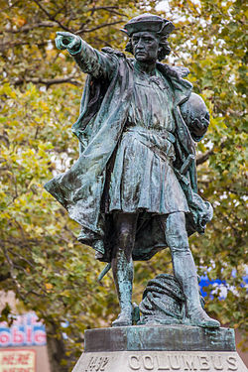
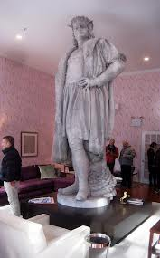
Admiration
Columbus has long been admired in America. There are more monuments to Columbus here than in any other nation.

Slide 12
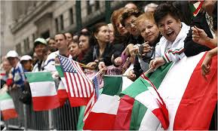
Italian celebration
Columbus Day also commemorates the arrival of Italian immigrants. It is the only day that celebrates the heritage of 26 million Italian Americans.
Notes:
Insert a picture illustrating a custom or tradition.

Slide 13
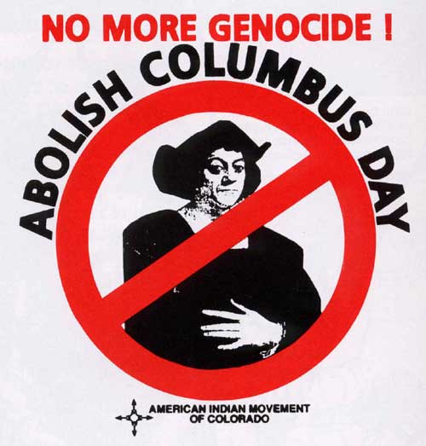
Counter Claim: Others May Say…
Some do not like the fact that Columbus is celebrated. They think that:
Columbus was looking for India, not the Americas. Out of ignorance, not realizing the actual size of the world, he believed that was where he was. He just happened to be in a New World. He died thinking he was in India. Columbus may have been seen as this magnificent sailor who found the Americas, but he was much more than that. Some think he was a greedy, hateful, selfish murderer. A holiday is a day to honor a person or event that had a positive impact on history. Columbus Day is typically thought of as the day to celebrate Columbus‘s great finding of the New World. Columbus is also taught as a great man who made a massive, life changing discovery. What is lacking is the awareness of the barbaric acts.
Notes:
Insert a picture of the head leader of your country.

Slide 14
Refutation
We disagree. Although Columbus made mistakes, he was still a great contributor to our society today.
Besides most of the violence against the Native Americans was done by his men, not him.

Slide 15
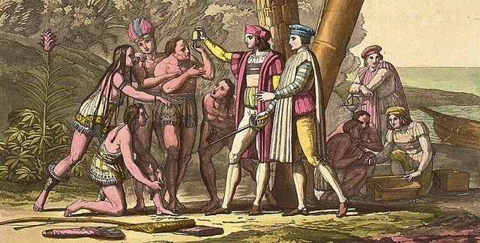
Conclusion
Columbus was a great explorer, even if he did make mistakes. Without his discoveries, we would not have the same society that we do today. Columbus has shaped the way we live, and he really was amazing. That’s why he deserves a holiday.
Notes:
Insert a picture that illustrates some part of your country’s economy.

Slide 16
Bibliography
http://geography.about.com/od/christophercolumbus/a/columbus.htm
www.britannica.com
Article by: The Order Sons of Italy in America in Washington
http://askville.amazon.com/celebrate-Columbus-Day/AnswerViewer.do?requestId=61145152
Notes:
Insert a picture of one of the points of interest for your country.

